Slide 1
JavaScriptExecutor
<Ashok Beenidi>, Nagpur GDC

Slide 2
JavaScriptExecutor
JavaScript Executor is an Interface which provides mechanism to execute JavaScript through selenium driver.
In Selenium web driver, locators like XPath, CSS, Etc.. Are used to identify and perform operations on a web page. In case, we are unable to perform operations by using locators we can use JavascriptExecutor.
You can use JavascriptExecutor to perform an desired operation on a web element.
Selenium support javaScriptExecutor. There is no need for an extra plugin or add-on. You just need to import (org.openqa.selenium.JavascriptExecutor).

Slide 3
When we go for JavaScript Executor?
To handle scroll bars (Horizontal & Vertical).
For Highlighting any information or text or element in web page.
Sending the values into text field.
Methods in JavaScript Executor:
Java Script Executor provides two methods, To run java script on the current page.
1.executescript
2.executeAsyncScript

Slide 4
ExecuteScript Method
This method executes JavaScript in the context of the currently selected window in selenium.
Syntax:
JavascriptExecutor js = (JavascriptExecutor) driver;
js.executeScript(“Script”, Arguments);
Script: This is the JavaScript that needs to execute.
Arguments: It is the arguments to the script. It’s optional.
The script can return values. Data Types returned are Boolean & Web Element & String and List.

Slide 5
ExecuteASyncScript Method
If application waits for some time to perform a further action than we go for executeASyncScript.
Syntax:
JavascriptExecutor js = (JavascriptExecutor)driver;
//Call executeAsyncScript() method to wait for 5 Seconds
js.executeAsyncScript("window.setTimeout(arguments[arguments.length - 1], 500);");

Slide 6
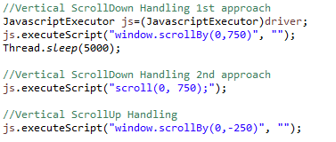
How to handle Scroll Bar
Window object represents an open window in a browser.
ScrollBy() method scrolls the document by the specified number of pixels.
To scroll the webpage by 750px vertically for this case script like,
Window.scrollBy(0,750); //Scroll 750px to the down

Slide 7

How to Highlight Web Element
If you want to Highlighting any information or text or element in web page, first inspect it and store into web element.
We need to pass web element instance as an argument to ExecuteScript method.
In Script we are assign style, border color to the argument.

Slide 8
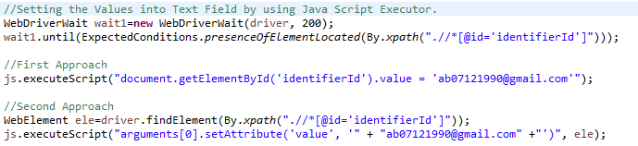
How to set values into text field
Document Object :
The document object will represents the work area with in the opened browser window.
If you want to access any element in an HTML page, you always start with accessing the document object.
Finding HTML Elements:
document.getElementById (Id) : Find an Element by Element ID

Slide 9
Some of other Examples
How to enter the value into textbox.
How to click a button
How to refresh a window
How to get the text of a particular web element
How to get the title of the webpage
How to scroll vertically for certain pixels
How to scroll till the bottom of the webpage
How to scroll a particular element
How to navigate back to page
How to navigate to next page

Slide 10

Any Questions

